Slide 1




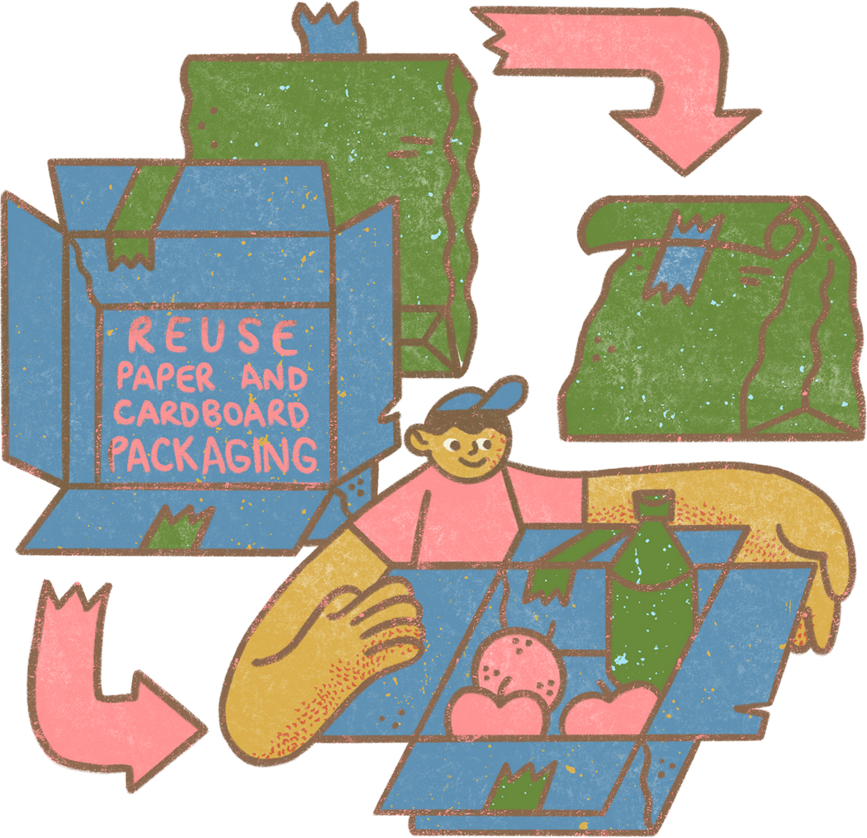



ECO-Hustle
Hustle for greener tomorrow.

Slide 2
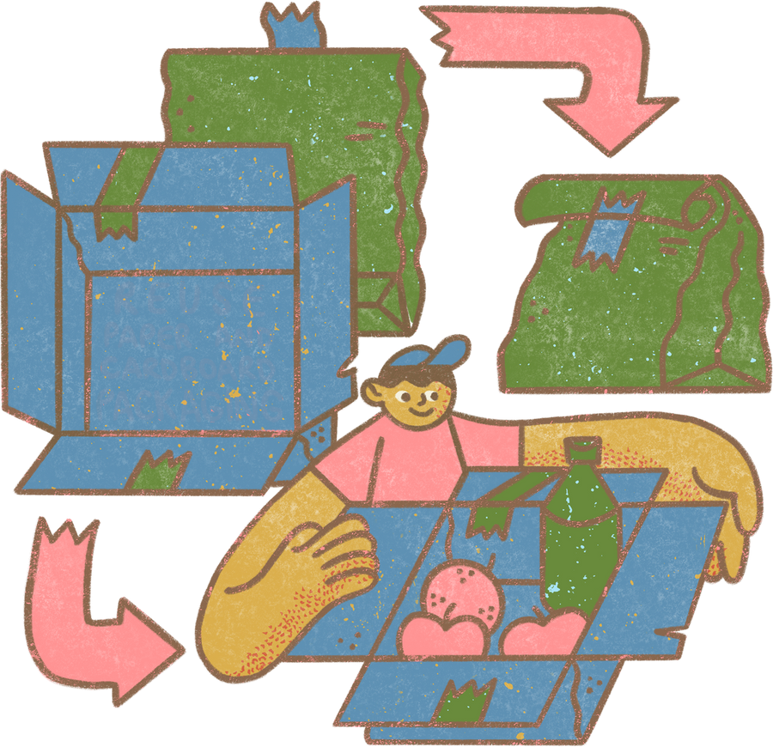
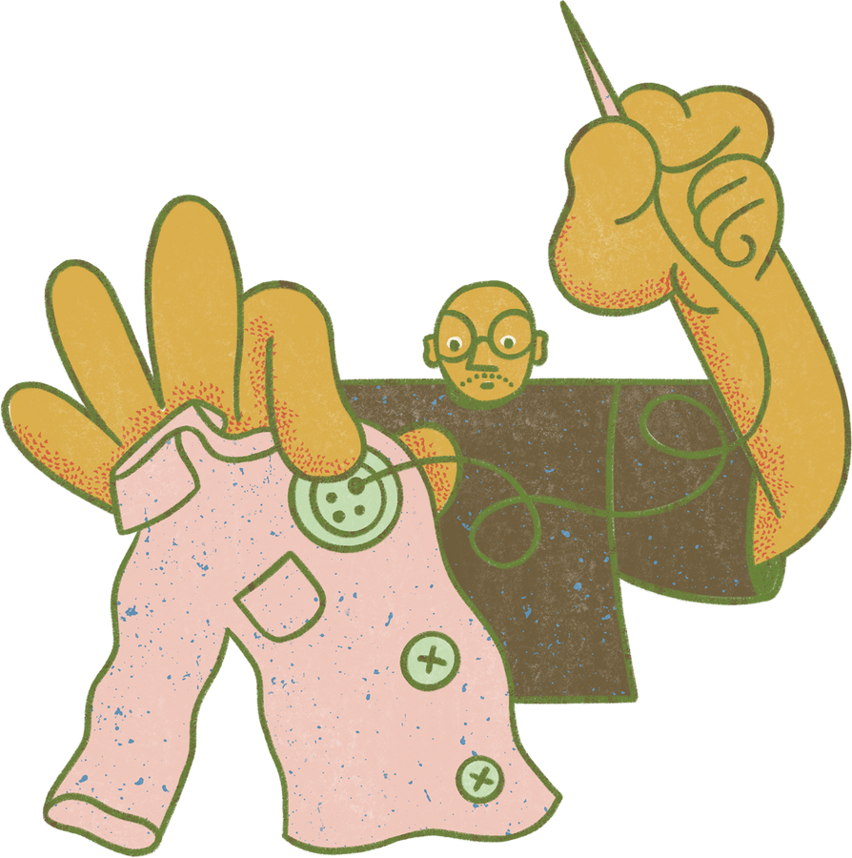



ECO-HUSTLE: A DIY KIT for Urban green action
EcoHustle enables people and groups to repair nature with simple, hands-on tools. It mixes environmentally friendly materials with technological help, such as QR-coded video instructions, allowing anybody to plant, compost, and care for green areas from their homes

Slide 3

What is inside the box
Pre-packed seed balls with location-specific native species.
Pocket soil test strips for soil compatibility.
QR-code linked tutorials (composting, seed ball use, soil improvement).
Starter compost pouch.
Green Progress Tracker Sheet (physical or digital).

Slide 4




Green Points System
Gamified Engagement
Plant trees (Upload photo via QR code verification).
Maintain Saplings (Monthly photo logs)
Organizing local drives and referals
Weekly eco-themed puzzles

Slide 5
Social Media Integration
Each EcoHustle kit has a unique QR code
Scan → Upload action photo → Auto-generates a pre-designed post
Hashtags like #EcoHustle or #GreenWithMe
Builds peer pressure + positivity loop in society

Slide 6

Target Users and Reach
Primary Users
Scalable Through
Partnerships with municipal bodies
Sponsorship by eco-conscious brands
Schools
NGO’s
Households

Slide 7



Thank You
"If not now, then when? If not us, then who?"

